Slide 1
Phoenix Children’s Hospital: A Journey in Branding
NAHCR 2018
Notes:
Rush Recruiting January 5, 2017

Slide 2
Who is your target for branding?
Potential Candidates
Customers
Employees
Vendors
Competition
Community

Slide 3
Phoenix Children’s Hospital: A look through our branding journey
But first…
Non-Disclosure
Position of Vulnerability

Slide 4
What Have I walked into??
Overworked Recruiters – 120 – 150 requisitions each
Management by Frustration
Career site too wordy
Application process cumbersome
No attention to customer experience
HR Departments functioning in silos
Company reviews ignored

Slide 5
Overworked Recruiters
Rebranded Department as Talent Acquisition
Moved from 3 recruiters to 7
Added On-Site Physician Recruiting

Slide 6
New Career Site

Slide 7
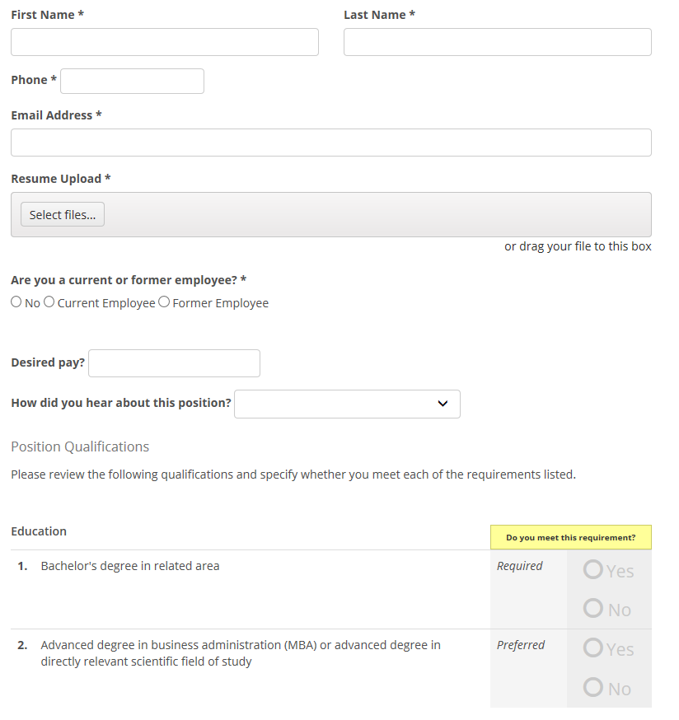
Quick Apply Application Flow
New Application Requires:
Name
Phone
Email Address
Resume
Current/Former Employee
Salary Requirements
Referral Source
Qualifying Questions

Slide 8
Candidate Experience
Talent Board – Candidate Experience
Simplified Application Process
Notifications to candidates
At Resume Received
At Not Selected
Additional Educational Opportunity in-between (potential)
Career Site monitored email account
Upcoming Chat functionality

Slide 9
Improved Departmental Experience
Weekly Huddle
Department/Company updates
Highlight wins
Celebrate birthday/anniversaries
Quarterly HR Meetings offsite
Charity Events (food bank, etc.)
Team events (escape room)
Notes:
During work hours

Slide 10
Reviews: Good or Bad?
88% of Consumers Trust Online Reviews as Much as Personal Recommendations.

Slide 11
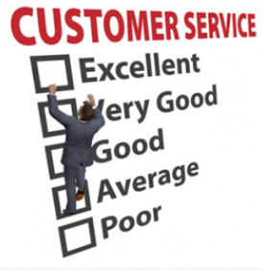
Importance of Company Reviews
Provides the trust your brand needs on the internet
Allow customers to feel more comfortable working with you
Provide a unique opportunity to gather feedback about your products and service
Makes your brand visible and increases exposure
Helps gain publicity and reputation
Understand and Better Serve Your Customer
Improve Rankings
Allow Consumers to Have a Voice and Create Customer Loyalty
Create Consumer Engagement
Let Consumers Do Your Marketing For You
Notes:
Final Web Design January 9, 2018 and The Online Department Blog – June 25, 2012

Slide 12
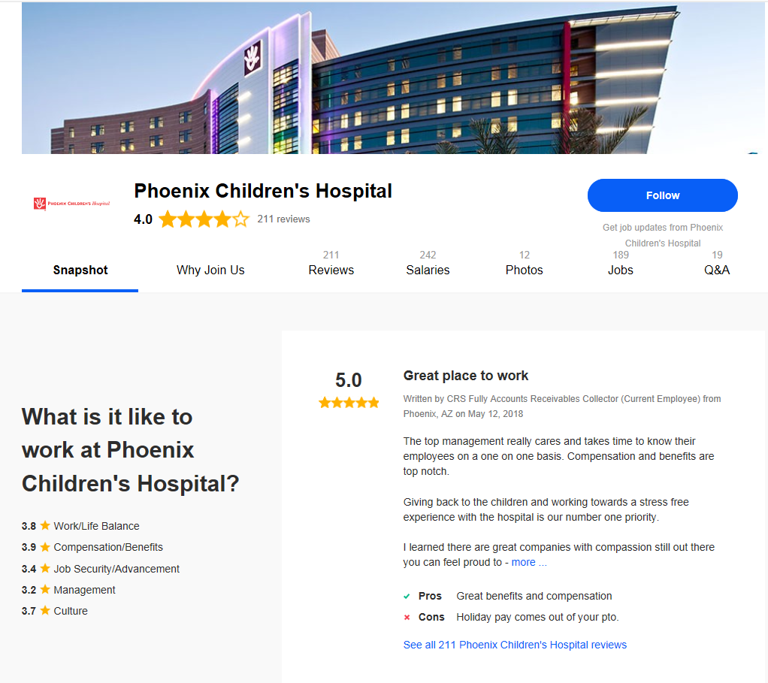
Company Reviews
Indeed

Slide 13
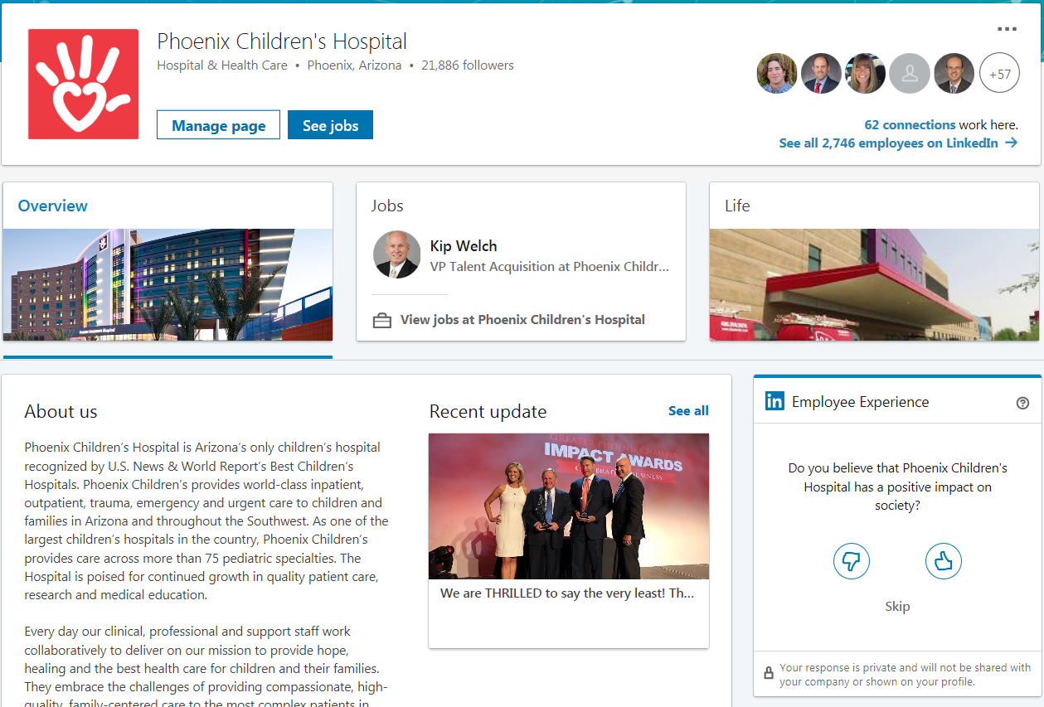
LinkedIn
Success on LinkedIn is:
Increasing followers
Providing video content often
Ensuring profile is complete

Slide 14
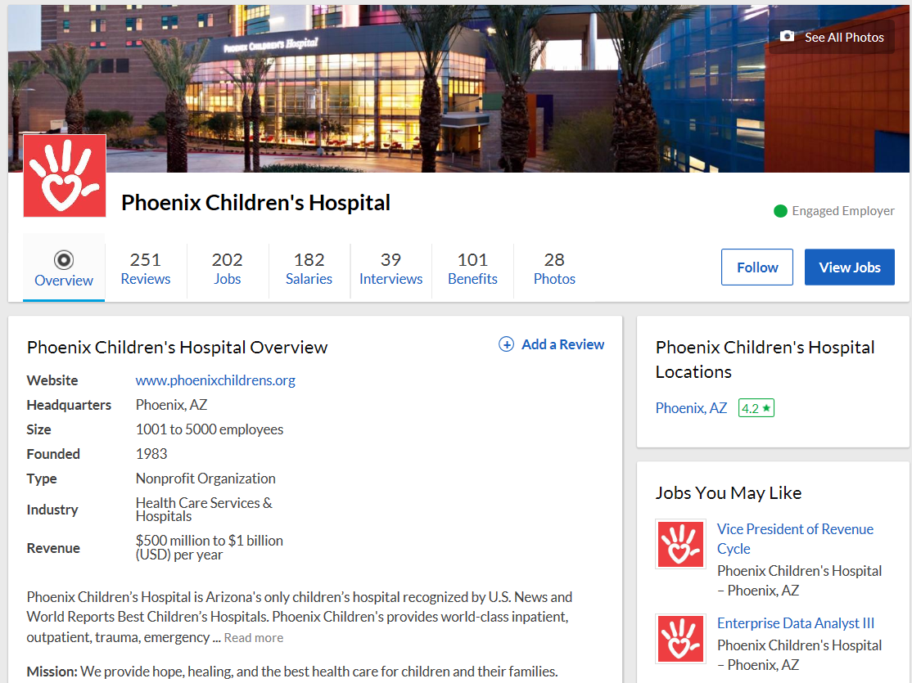
Glassdoor
Half of job seekers use Glassdoor at some point in their job hunt.
Glassdoor ranks more than 250,000 businesses
Notes:
Axia Public Relations 6/29/15

Slide 15
PCH: A Look Back
June, 2016
Overall Rating 2.6
CEO Approval 58%
0ver 9,000 views per month
Mostly all negative reviews

Slide 16
PCH: Strategy to Raise Glassdoor Brand
New Hire Orientation
Exit Interviews
Targeted campaign using digi-boards, company newsletter
Partner with Glassdoor
Notes:
Any other ideas?

Slide 17
Benefits of Glassdoor Partnership
Increase brand through content
Access to Analytics
Competitor Comparisons
Cross-Marketing to non-Glassdoor partners
Customer Service and Support

Slide 18
PCH/Glassdoor Results
 | June 2016 | Today
Overall Rating | 2.6 | 4.1
CEO Approval | 57% | 86%
Profile Page Views Monthly | <9,000 | 19,352
Reviews Views in last 30 days |  | 10,411
* As of 5/31/18

Slide 19
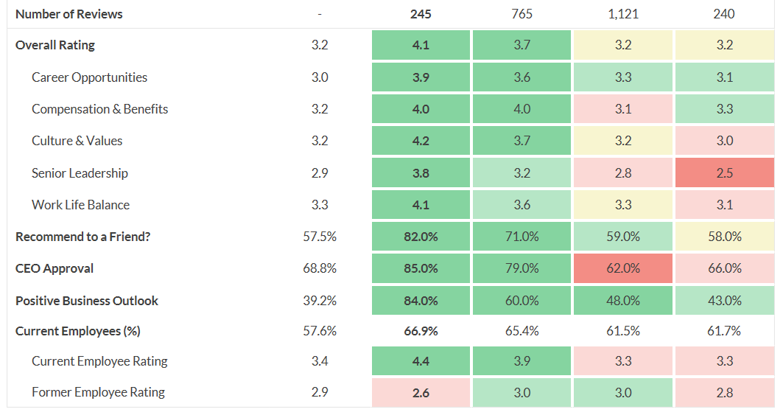
Competitor Comparisons

Slide 20
Summary
Branding should reach farther than just your candidates
Career Site is your first impression
Consider Application workflow with candidate ease in mind
Relationships with hiring managers is the most important factor in building a Talent Acquisition strategy
Make sure you are maximizing your potential with social media partners
Find opportunities to bring different groups within HR together to learn and to socialize
Include Glassdoor as part of your Recruiting Strategy
Too many views to ignore
Can be used as a branding tool
Work proactively to increase your position and scores
Monitor your competitors

Slide 21
Questions???

Slide 22
