Slide 1
Using Video to Source Candidates and Increase SEO
By Thomas F.X. Licari
HonorHealth
Thursday July 12th 2018

Slide 2
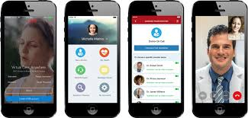
Brief Pre-Introduction
Video is so valuable!
Let me explain

Slide 3
Video Recruitment?
Joseph Segel is an American entrepreneur. He is the founder of over 20 American companies, most notably QVC, an American television network, and the Franklin Mint, a producer of mail-order collectibles.

Slide 4
Who is this guy?
Michael J. Lindell is the inventor and CEO of My Pillow, Inc.

Slide 5
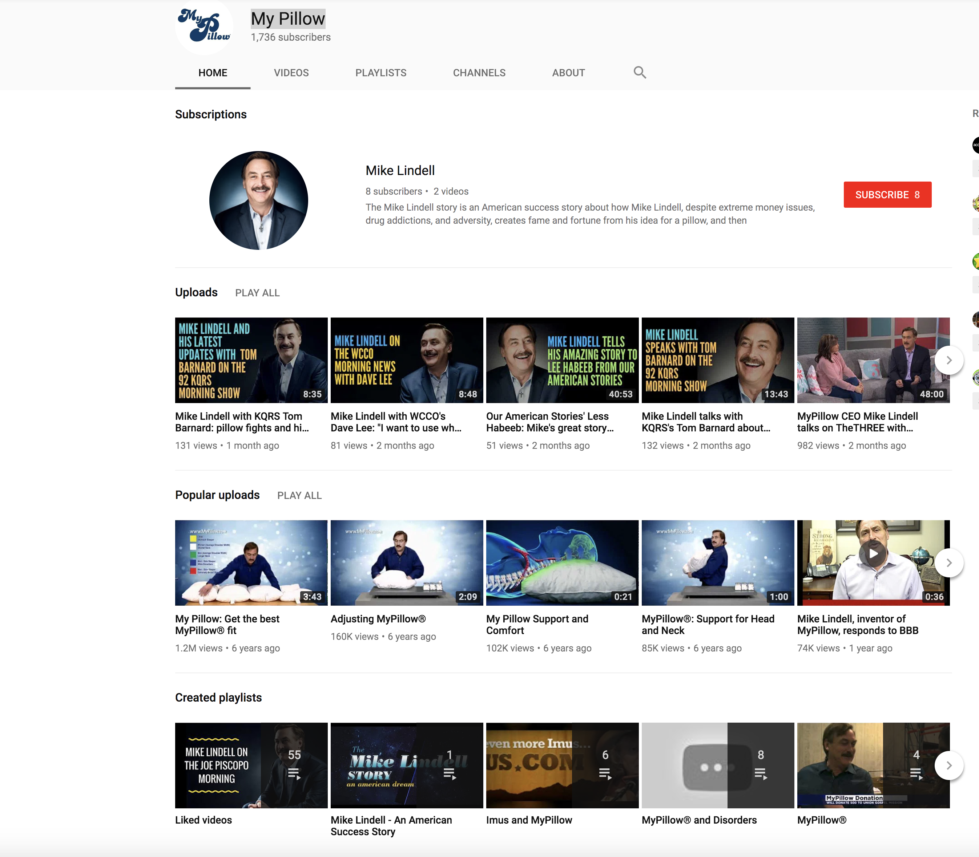
What?
https://youtu.be/-bhjTWBVt4o
Why am I telling you about this?
What does this have to do with SEO and Video Recruitment?
He has Subscribers? For a pillow commercial?!

Slide 6
Psychology of Selling
https://youtu.be/WJffi1TgM2M

Slide 7
Keep all this in Mind as we truck on…

Slide 8
Ambitious Agenda
To show you how to build a recruitment platform using video.
Attract candidates with more dynamic messaging.
How to make videos.
Speaking directly to candidates on a volume scale.
Give your potential candidates a peek into the work life.
Video will increase your level of successful close.
Brand yourself in the medical space, have candidate call you.
Increase your search engine visibility!
Warning and pitfalls

Slide 9
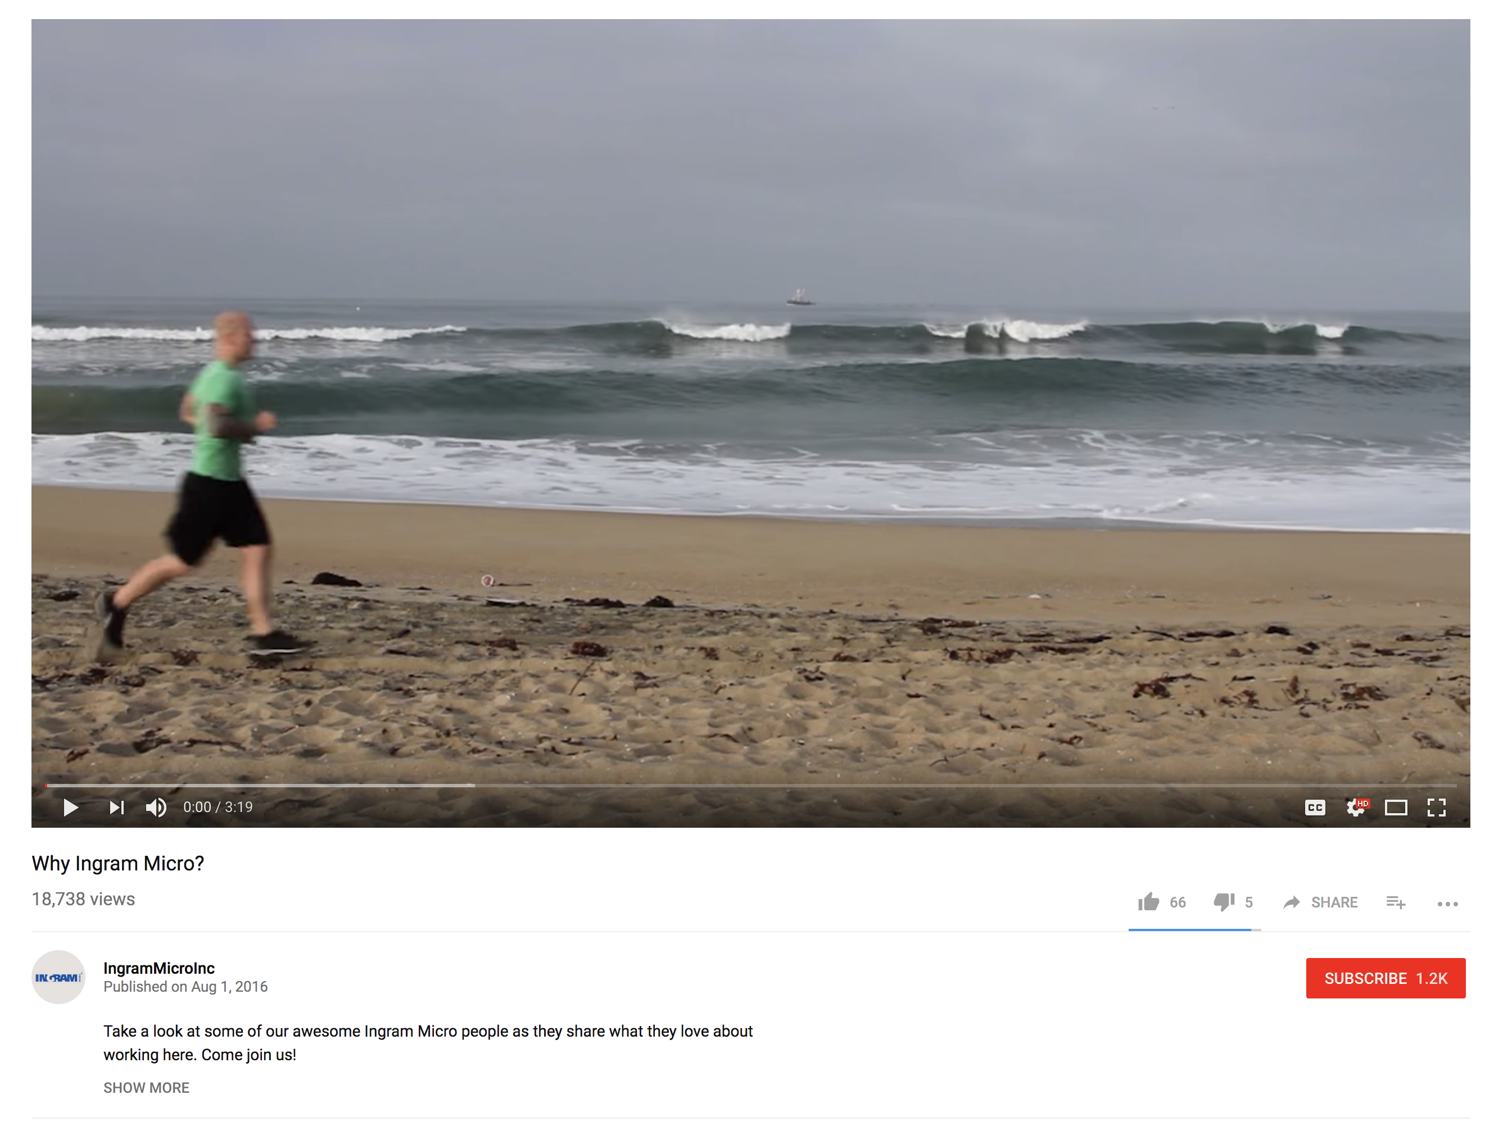
Let’s Set the Table
https://youtu.be/kWaJ7_62MQY
Notice the amount of views
18K plus
Question:
How did they get in two years?
How does Micro use this video?

Slide 10
Before we can start making video’s
Keep top of Mind.
We need to build a running list:
SEO
Tags
Titles
Top of Mind
Running lists while creating developing

Slide 11
Search engine optimization (SEO; Tagging, Titling)
The process of affecting the online visibility of a website or a web page in a web search engine's unpaid results—often referred to as "natural", "organic", or "earned" results. In general, the earlier (or higher ranked on the search results page), and more frequently a website appears in the search results list, the more visitors it will receive from the search engine's users; these visitors can then be converted into customers.
SEO may target different kinds of search, including image search, video search, academic search, news search, and industry-specific vertical search engines. SEO differs from local search engine optimization in that the latter is focused on optimizing a business' online presence so that its web pages will be displayed by search engines when a user enters a local search for its products or services. The former instead is more focused on national or international searches.

Slide 12
Let all get on the same page
Thoughts to consider
Building a story board
Integrate your Recruitment Functions and Philosophy

Slide 13
Functions of a Tremendous Recruiter
True Consultant
Example “Recruitment intake discussion”
Develop position descriptions (this is part of your storyboard)
Integrate with existing hospital brand recognition campaigns
Understand talent pool
Research and know your competitors move in the space
Design sourcing marketing strategies that are different
Select your message
Direct market to both active and passive candidates
Sell

Slide 14
Recruitment Philosophy
Brand Recruiter within line(s) of business
Get back to everyone (Good, Bad, Indifferent)
Recruiter tip; you can develop message templates that don’t seem canned.
Social Media with a purpose
Direct your messages and videos to your audience
Targeted messages, using #hashtags and other discovery methods
Video messages must tell a story and convey a message.
Recruiter tip; Keep them short!
Always be brief and selling
Making certain to cover the details and end with a call to action

Slide 15
Build your idea into a video
Description Understanding
Position Brief
Your Hospital
Speak to the talent pool
Show them greatest
Call to Action
Current Marketing what is special maybe things you learned.
Intake discussion
Be specific

Slide 16
Check the boxes of understanding
Before we even get started with frame one
Let’s go make a video... | Done
SEO Functions
Life Cycle
Philosophy
Intake/Project
Idea Story Board
Well thought-out
Vetted

Slide 17
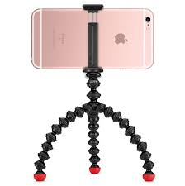
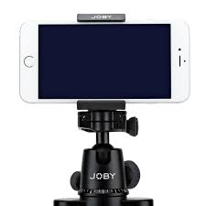
Basic Equipment List Needed To Start A Video Channel
There are four different items which necessary to have before uploading your first video.
Clear well thought out and vetted idea
Microphone
Video Camera, most of us have one in our pocket right now.
Video Editing Software
iMovie for Apple Mac, iPhone, iPad
Windows Movie Maker for Windows
Samsung Galaxy Video Editor App
Android Wondershare Filmora
All about the Tripod

Slide 18
Nursing Video
Video Example
https://youtu.be/6UUAQcLn_4c
Short to the point call to action Tags/SEO
Description All contact information

Slide 19
So where can we use video to recruit?
Answer:
EVERYWHERE
Does anyone in the room know this one?

Slide 20
Twitter with a Purpose
Direct message
Use Hashtags
Target special events
Just posting your message is not going to be enough.
Track your progress

Slide 21
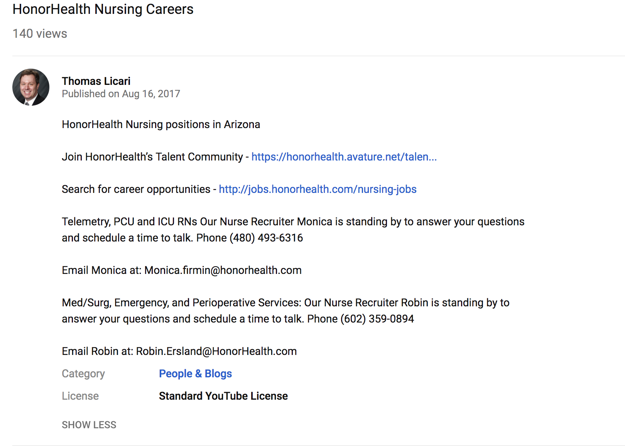
SEO Success Example
Top search result
Direct communication targeted talent pool with call to action

Slide 22
Track your Engagement

Slide 23
Track your progress
245 professionals clicked and read my position brief
One hire made and future pipeline created

Slide 24
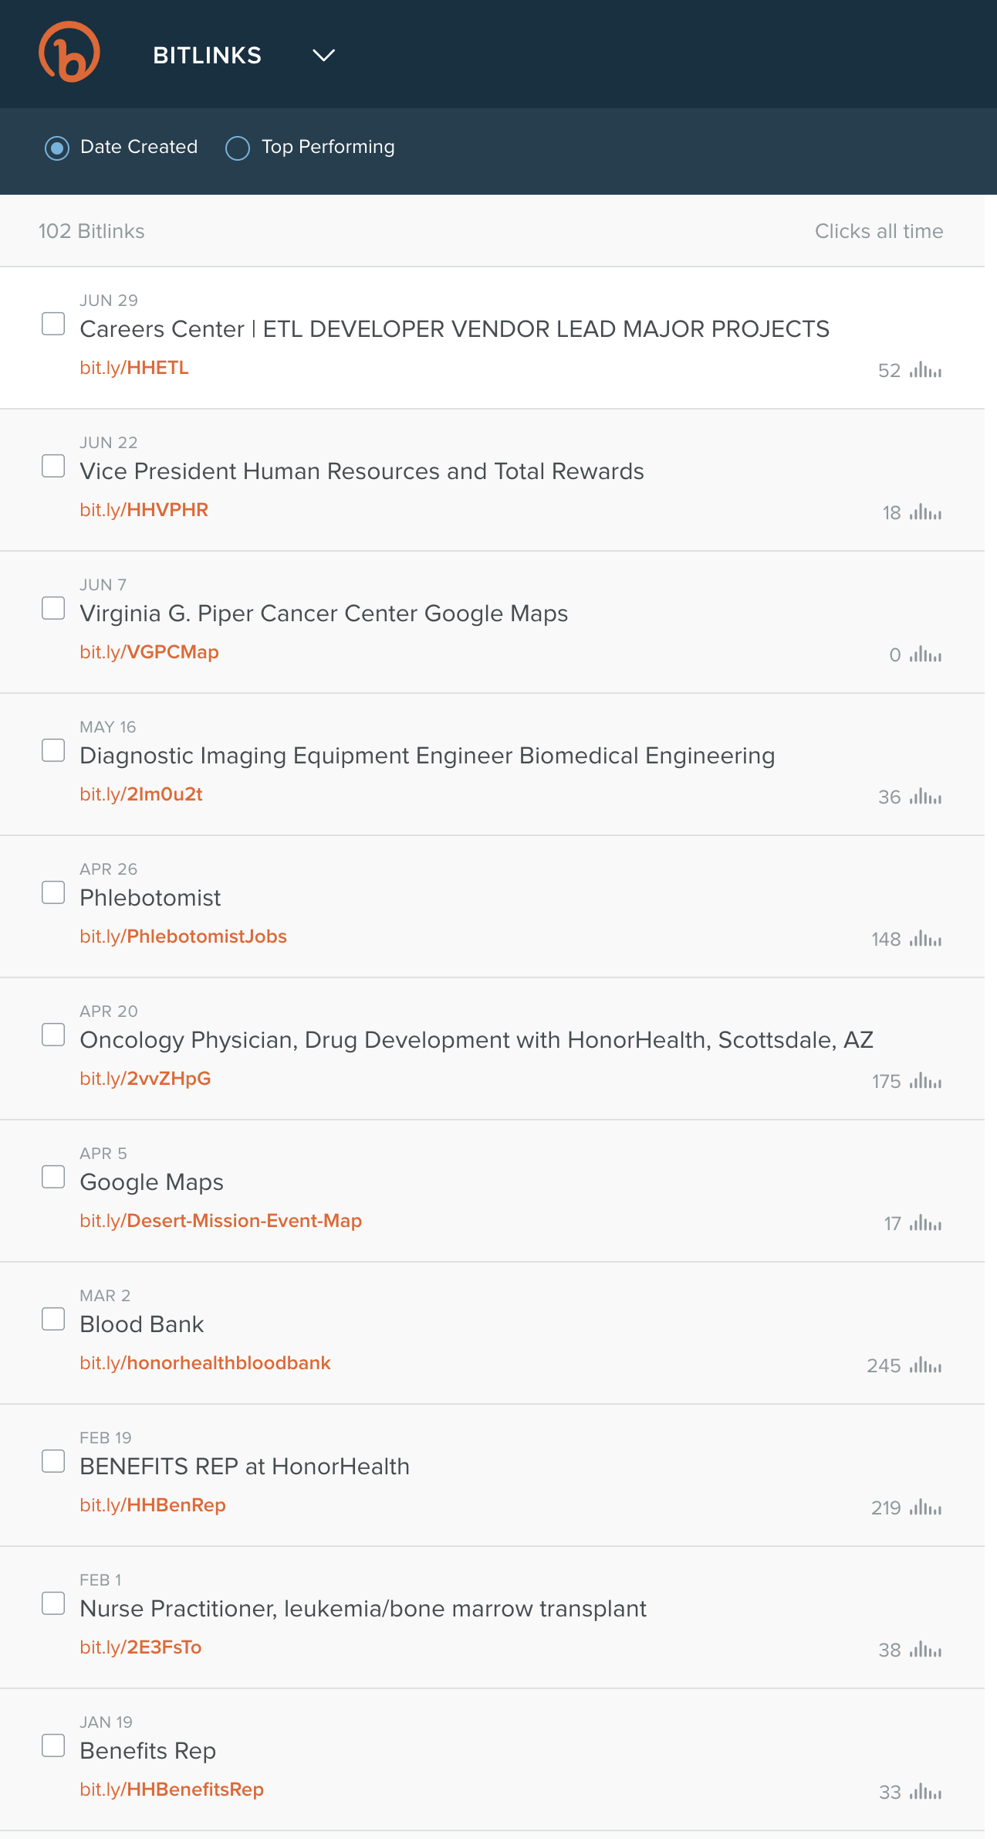
Bit.ly Link and track
Bitly.com - We optimize the link so marketers can own their customer experience.
Create video, find host, build a bit.ly link, add link to position description and track clicks

Slide 25
Where should I post my video?
Let’s get our Link on!

Slide 26
Create a Google/Youtube Account
To create a Google account:
Go to www.google.com.
Click Create an account.
The signup form will appear.
Review Google's Terms of Service and Privacy Policy, click the checkbox, then click Next step.
The Create your profile page will appear. ...
Your account will be created, and the Google welcome page will appear.
Youtube Channel
Sign into YouTube and click on the user icon at the top right of the screen.
Click on the gear icon to get to your account's YouTube Settings.
Click on Create a new channel.
Then choose “Use a business or other name”
Add your Brand name and click create.

Slide 27
Create a Video Channel
You’ll need a hosting service
YouTube - https://youtube.com which is owned by Google
Owned by Google means site rankings
Vimeo - https://vimeo.com
Wistia – https://wistia.com

Slide 28
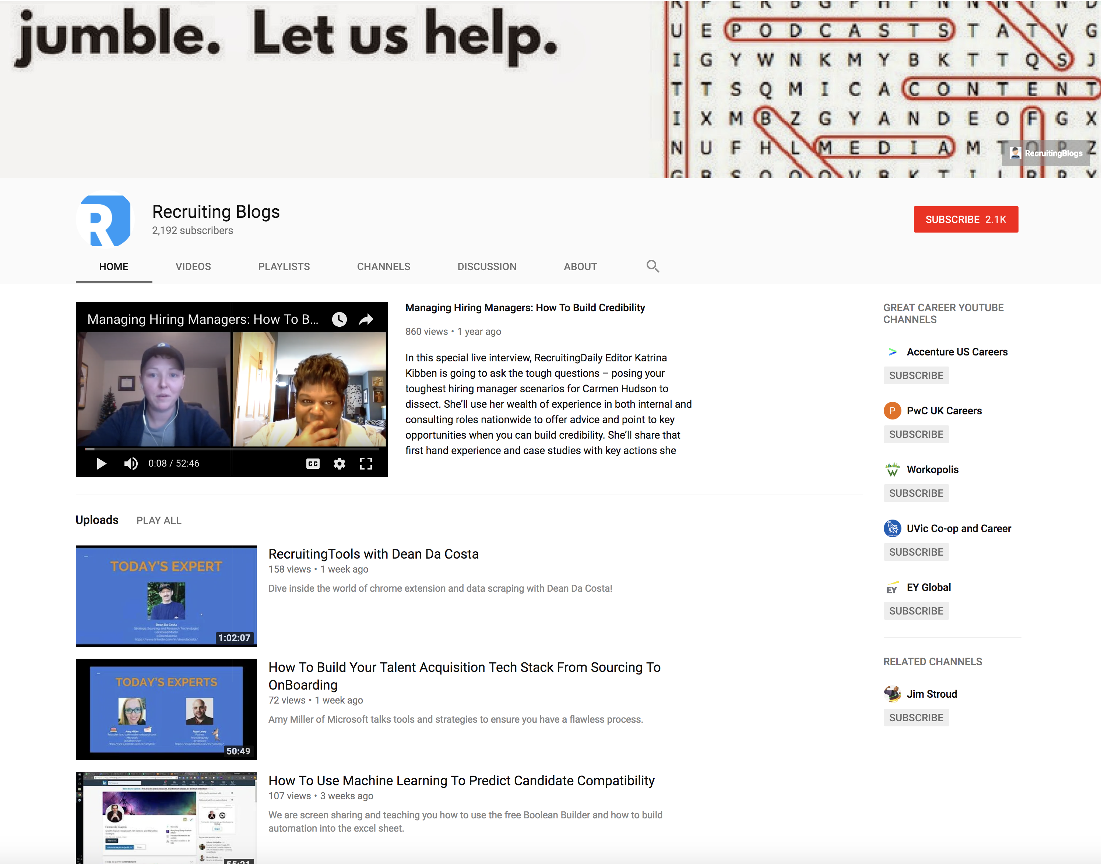
Example: Channel Detail

Slide 29
LinkedIn Supports Video (kind of)

Slide 30
LinkedIn using YouTube
Hit the share button

Slide 31
Submit Your Site to Google and Get Indexed For SEO
https://youtu.be/4xBWaXpZD7M

Slide 32
Using and developing SEO takes practice
First, generate a list of keywords ideas.
Youtube with generate suggested keywords are GREAT.
popular video in your niche… and copy the same keywords that video is optimized around.
YouTube “Traffic Sources –> YouTube search” report
Second, find the best keyword from your list
low-competition keywords
In general, Google tends to use video results for these types of keywords:
How-to keywords (“how to shave a cat”)
Reviews (“beats by Dre review”)
Tutorials (“Setting up WordPress”)
Anything fitness or sports related (“Cardio kickboxing”)
Funny videos (“Cute animals”)
These tips come from Mr. Dean’s article listed below.
Check out this link to a great article and how to by Brian Dean
https://backlinko.com/how-to-rank-youtube-videos

Slide 33
Friendly Recruiter Warning
Just don’t start making videos if you don’t have leadership approval
Check with your Marketing Dept they most likely will help
Might want to check with your Legal Dept
Do NOT video any patients, remember HIPPA laws
Rule of thumb to stay out of trouble
Make your videos about the positions description and hospital
If you get buy off from leadership you can get deeper.
Show off the team and environment

Slide 34
Thank you so much
Networking is Fun, please connect with me.
Thomas F.X. Licari
Talent Acquisition | HonorHealth
8125 North Hayden Rd. | Scottsdale, AZ 85258
Email: Thomas.Licari@HonorHealth.com
O: 602-448-1610 | HonorHealth.com
https://www.linkedin.com/in/licari
https://twitter.com/TFXL

